Slide 1
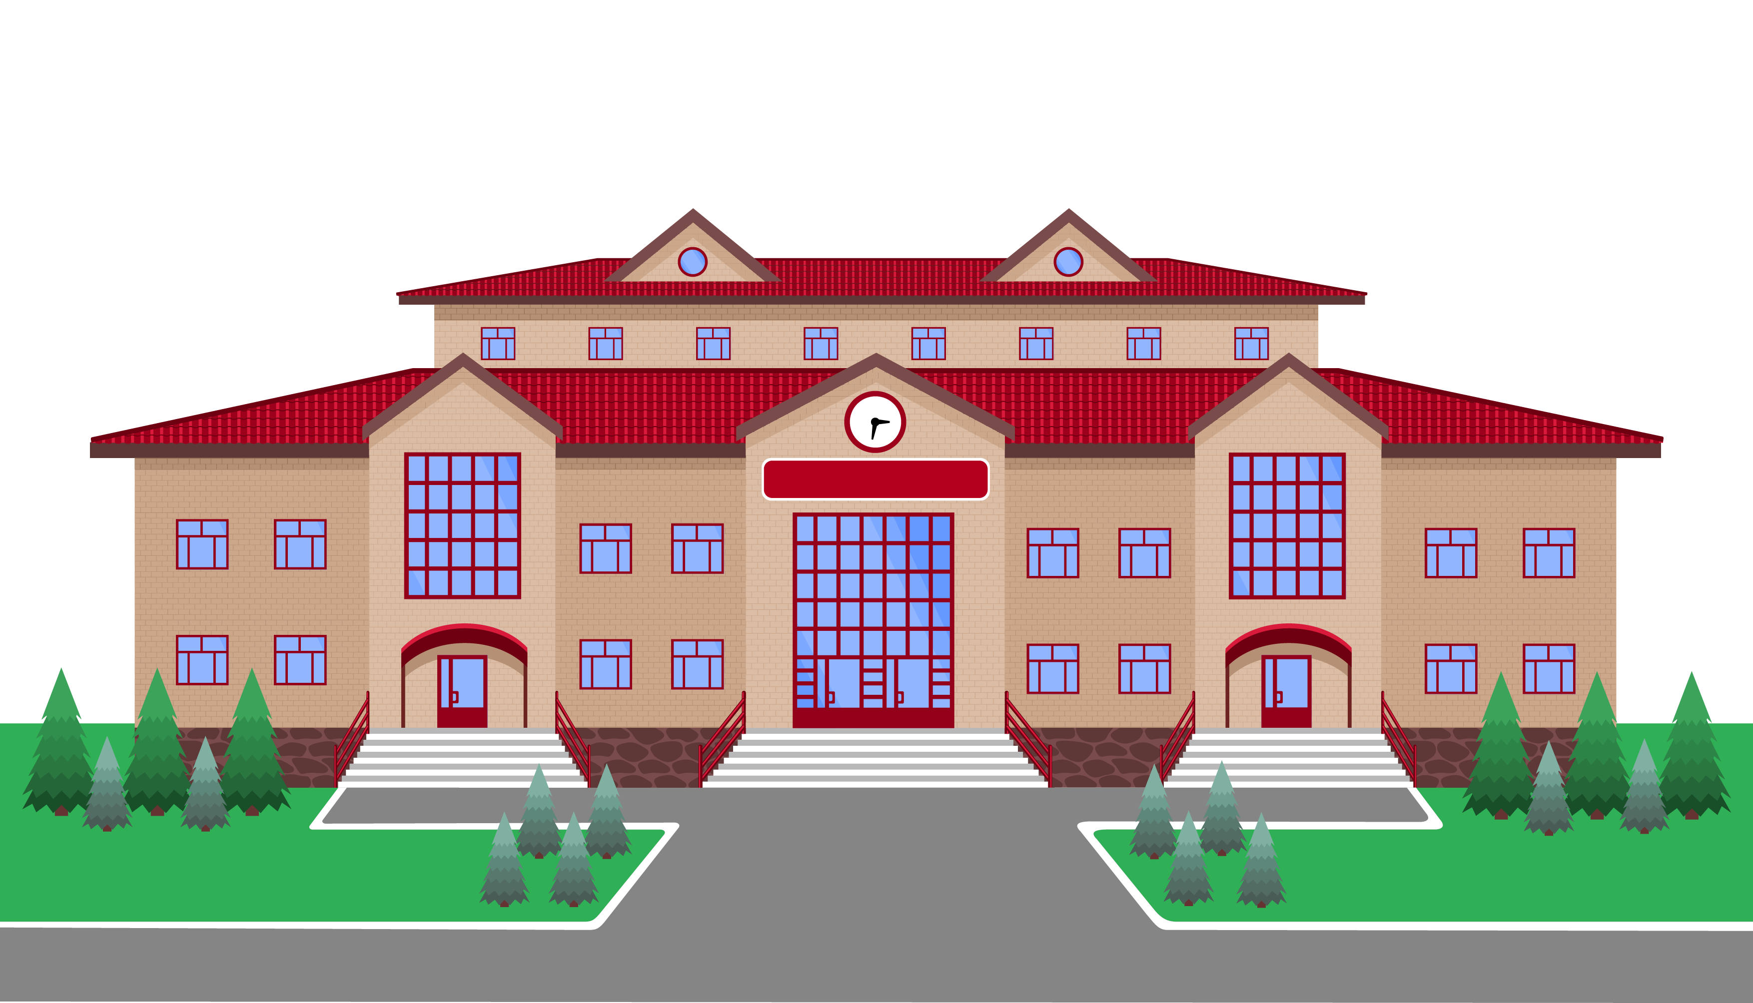
Your Website: Focal Point of All Your Digital Marketing Activities
Your website’s success is dictated by search engine rankings. To earn a good ranking, search engines expect to see the following when they scrutinize your website:
Easy to Navigate
Clean UX/Design
Well-Written Content that Relates Closely to Queries
Seen as Reliable by Other Authoritative Websites
Effectively Optimized for Search Engines
MySeniorLivingWebsite.com
MySeniorLivingWebsite.com

Slide 2
Organic Search Engine Optimization
Boosting Ranking Through Content + Technical SEO (on your site)
MySeniorLivingWebsite.com
Schema
Markup Code
Website
Backlinking
Site Speed
Php7 Script
Content
Relevancy
Google Data Suite
For search engines to crawl, organize, and display your content.
Another site links to your site - validates to search engines, that your content is relevant
Significant performance & security over previous versions
2X Bandwidth
75%+ Efficient
6X Faster
WordPress favored
Opted with keywords to drive organic search traffic. “Relevance” for a search engine, content must contain search terms
A suite of powerful measurement and tracking tools, that together create a complete business intelligence system.

Slide 3
Local SEO + Its Pivotal Role in Digital Marketing
All politics are local
and so are internet searches:
Google searches: 46% have “local intent”
“Near Me”: Mobile up 200% since 2018
Hyper-Local SEO is how local audiences find you
Directly ties to Google My Business inquiry volumes
Increased during COVID-19

Slide 4
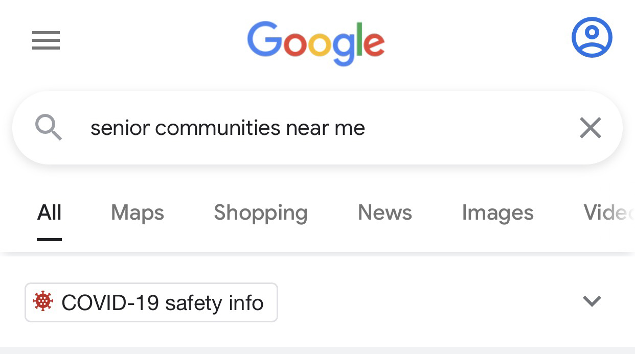
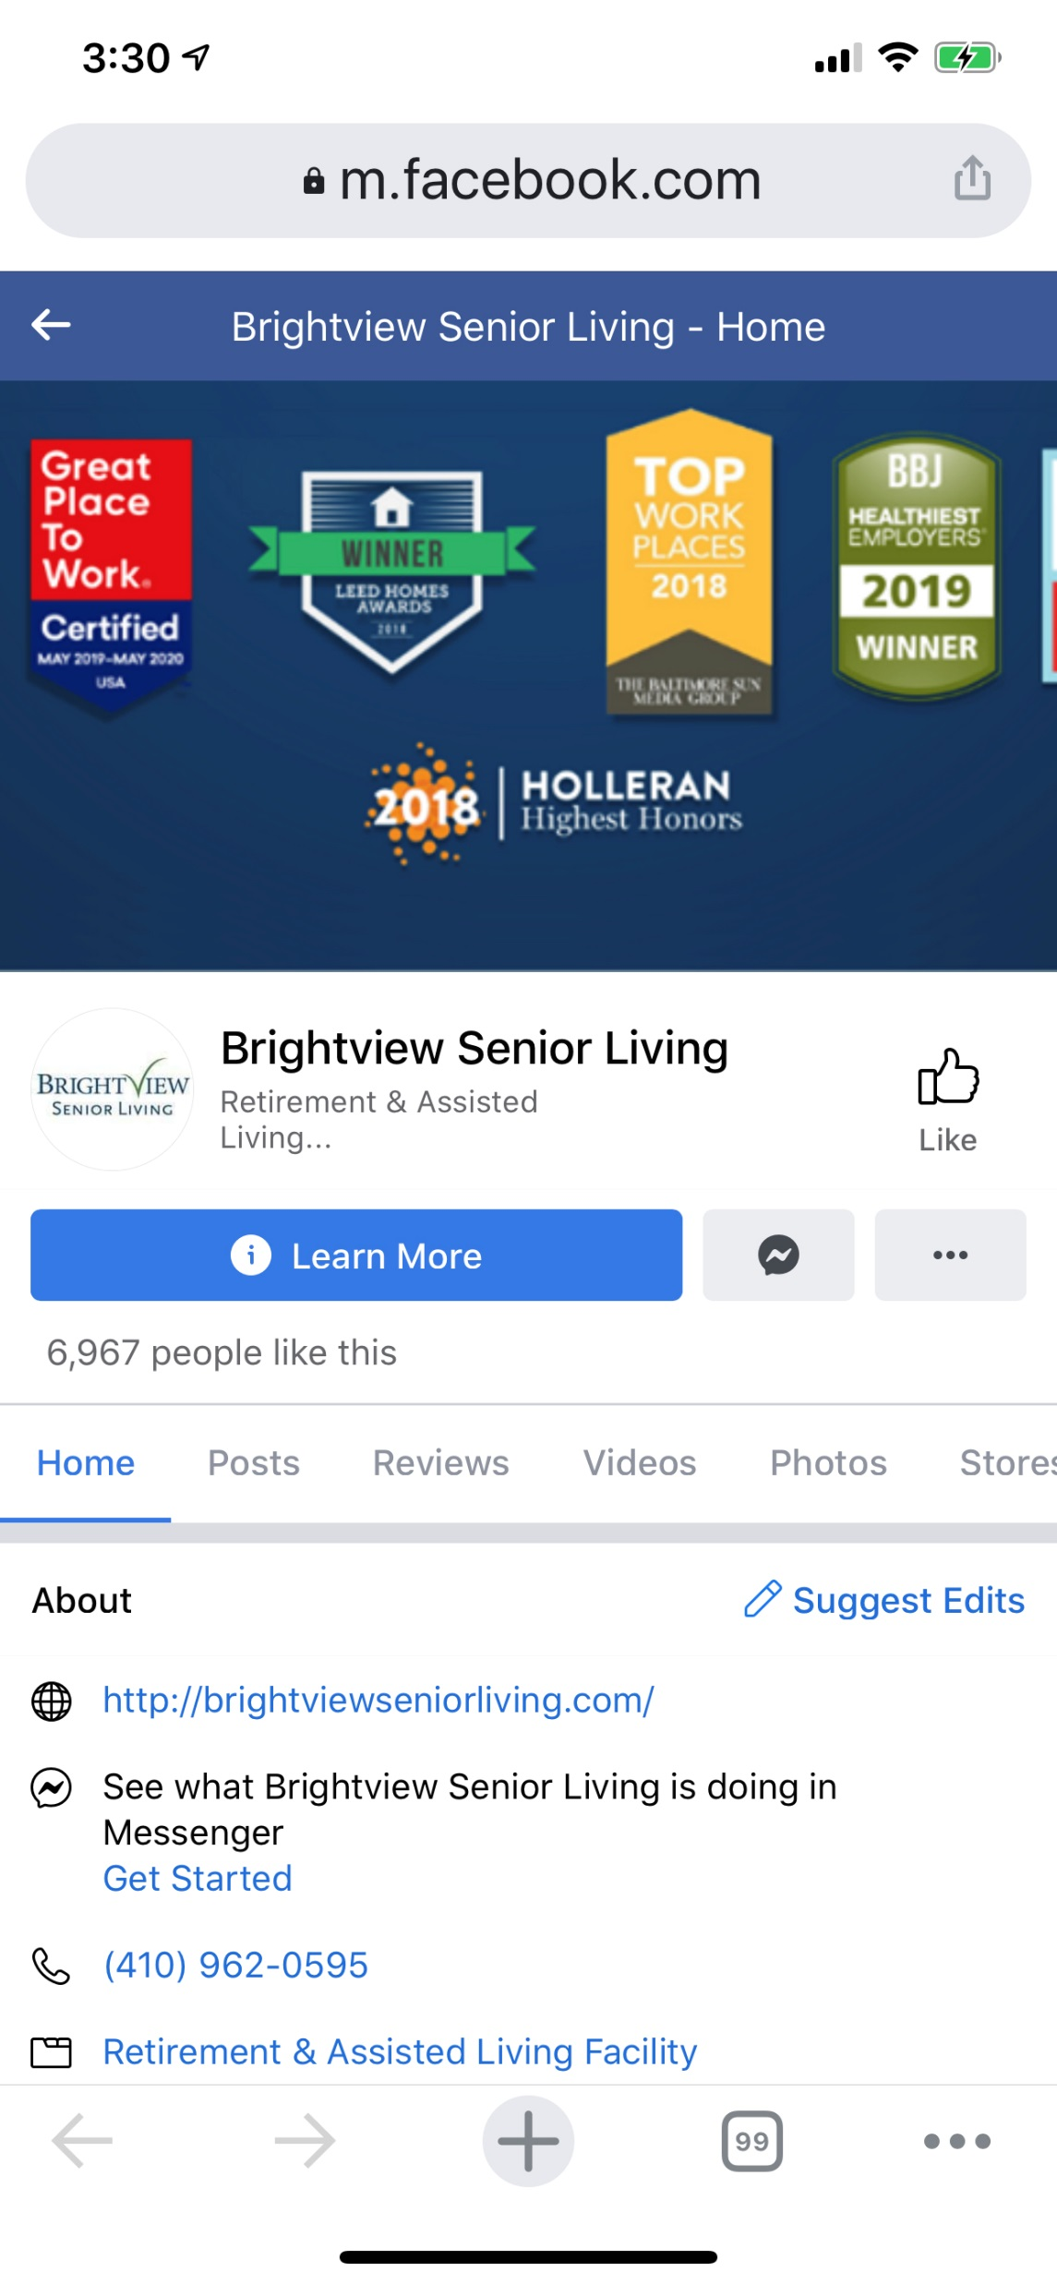
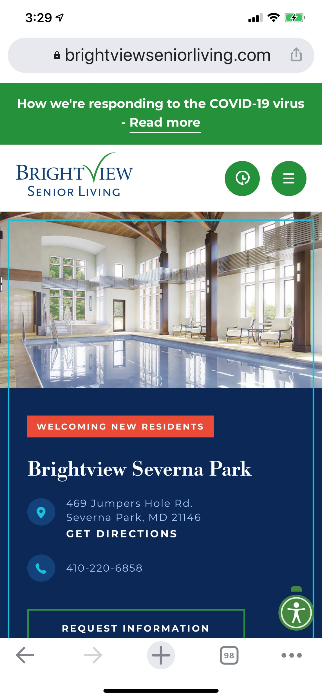
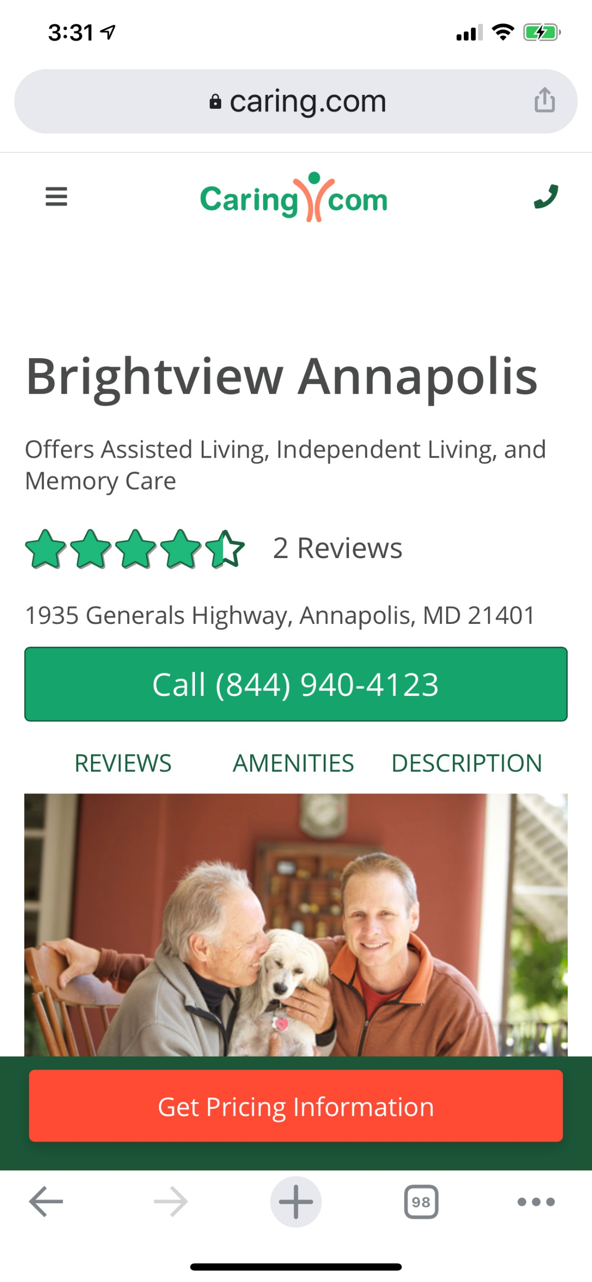
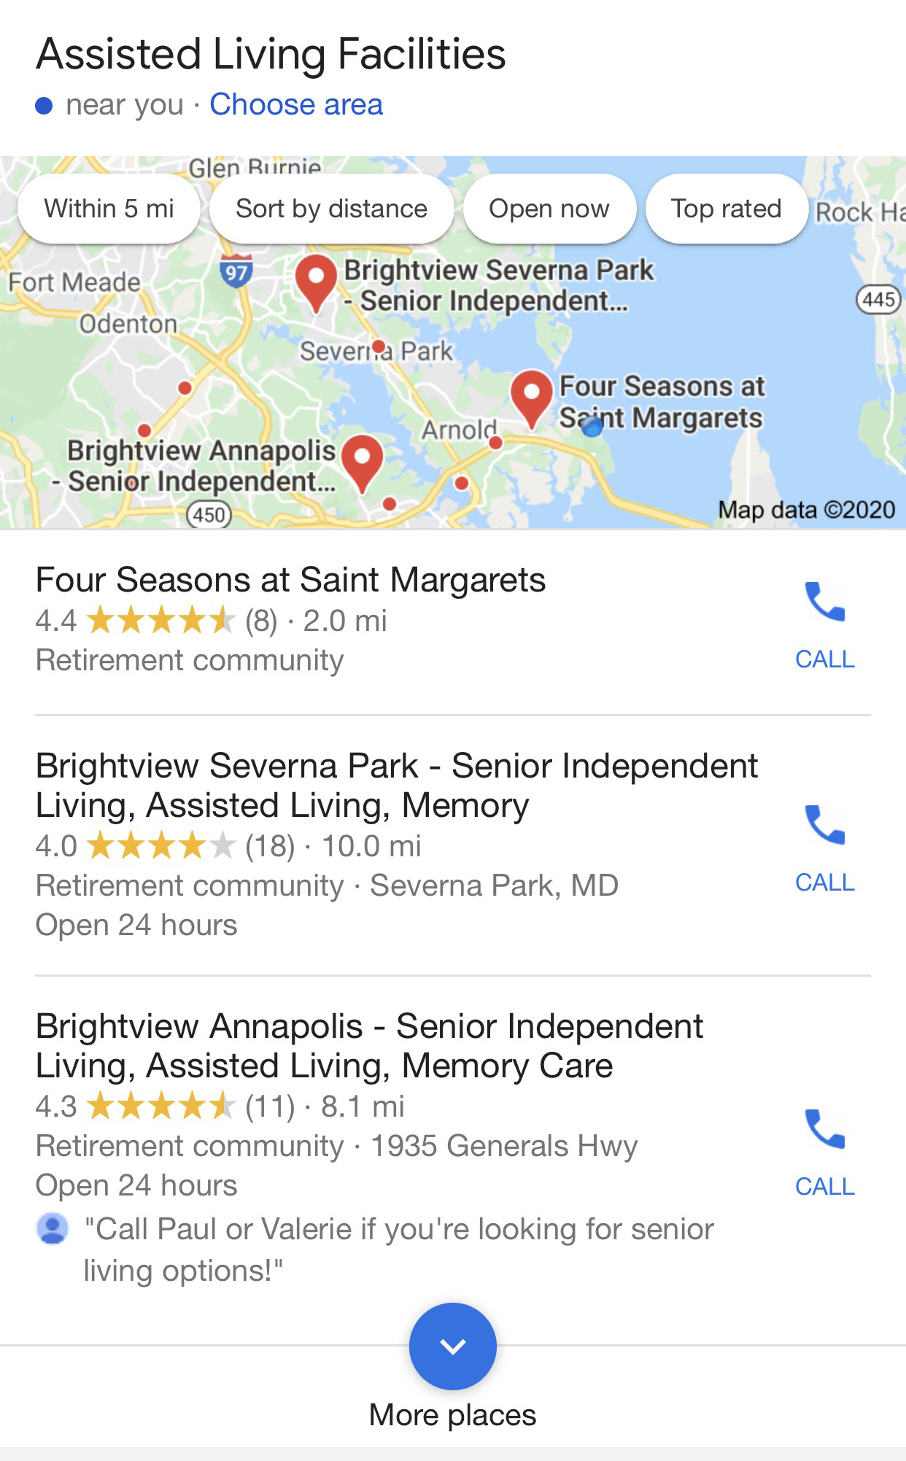
Google My Business:
Vital to Local SEO
Not every business understands why the Google My Business (GMB) profile is so important. The ones that don’t, are the same ones having difficulty increasing their web traffic.
Consistency is everything
GMB must match your website and listings across the internet
Google judges you by exact matches

Slide 5
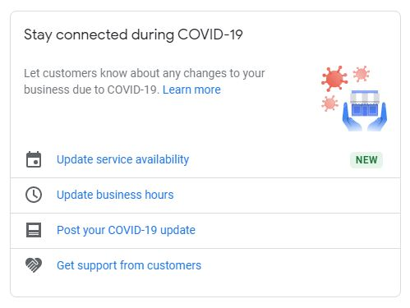
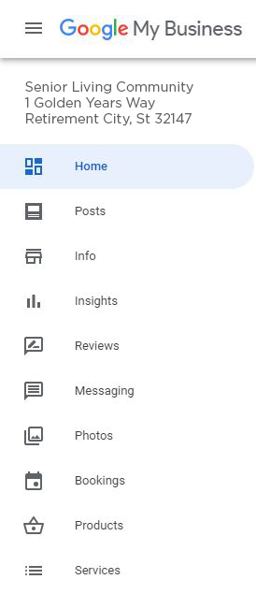
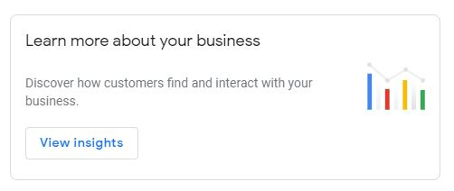
Action Steps
<
Keep information current
Conflicting info reflects poorly
Will affect your Google ranking
Don’t leave out any data
Missing data is a red flag
Take advantage of “Add another category” its an excellent keyword advantage
Utilize all the fields available
Solicit and respond to reviews
Take Advantage of
Topical Info + Data
<

Slide 6
Another Local Search Factor: Google Map Pack
The Map Pack are listings and maps of the top 3 local business results
Used 44% of the time by consumers
Map Pack listings, as well as the organic results below them, are the result of GMB optimization and your websites SEO.
These two tactics should be used in tandem to dominate page one results

Slide 7
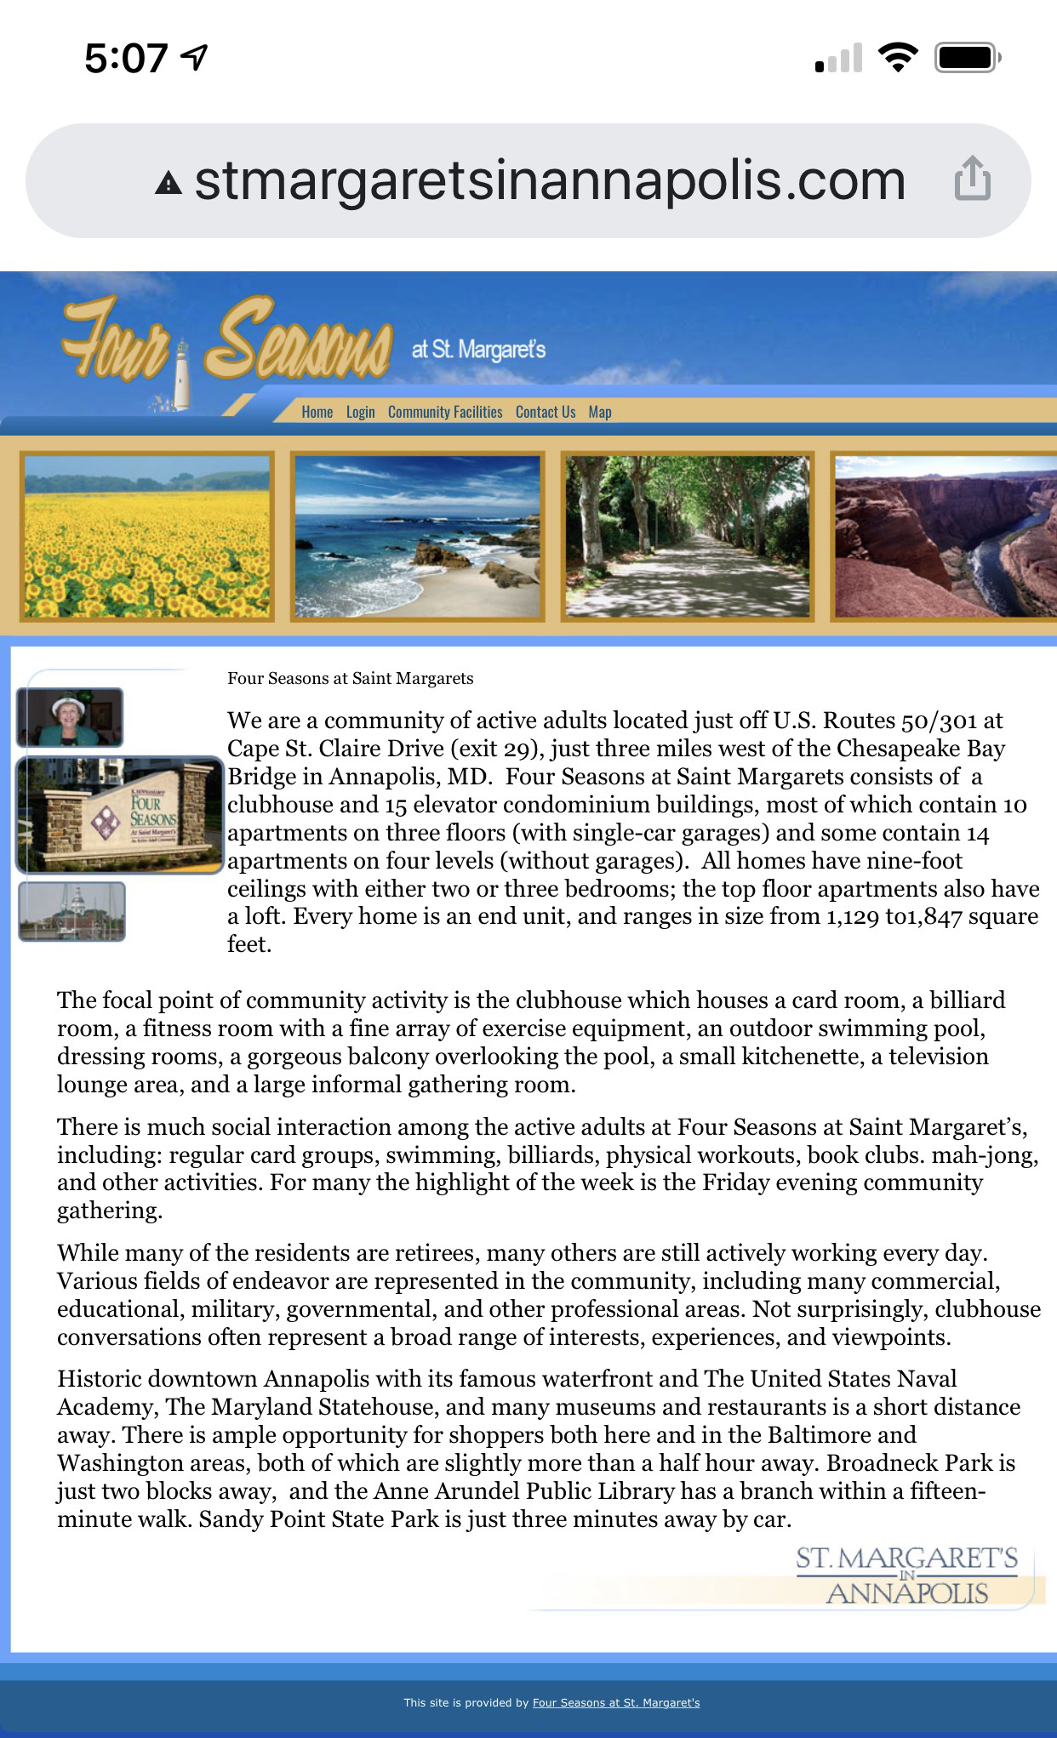
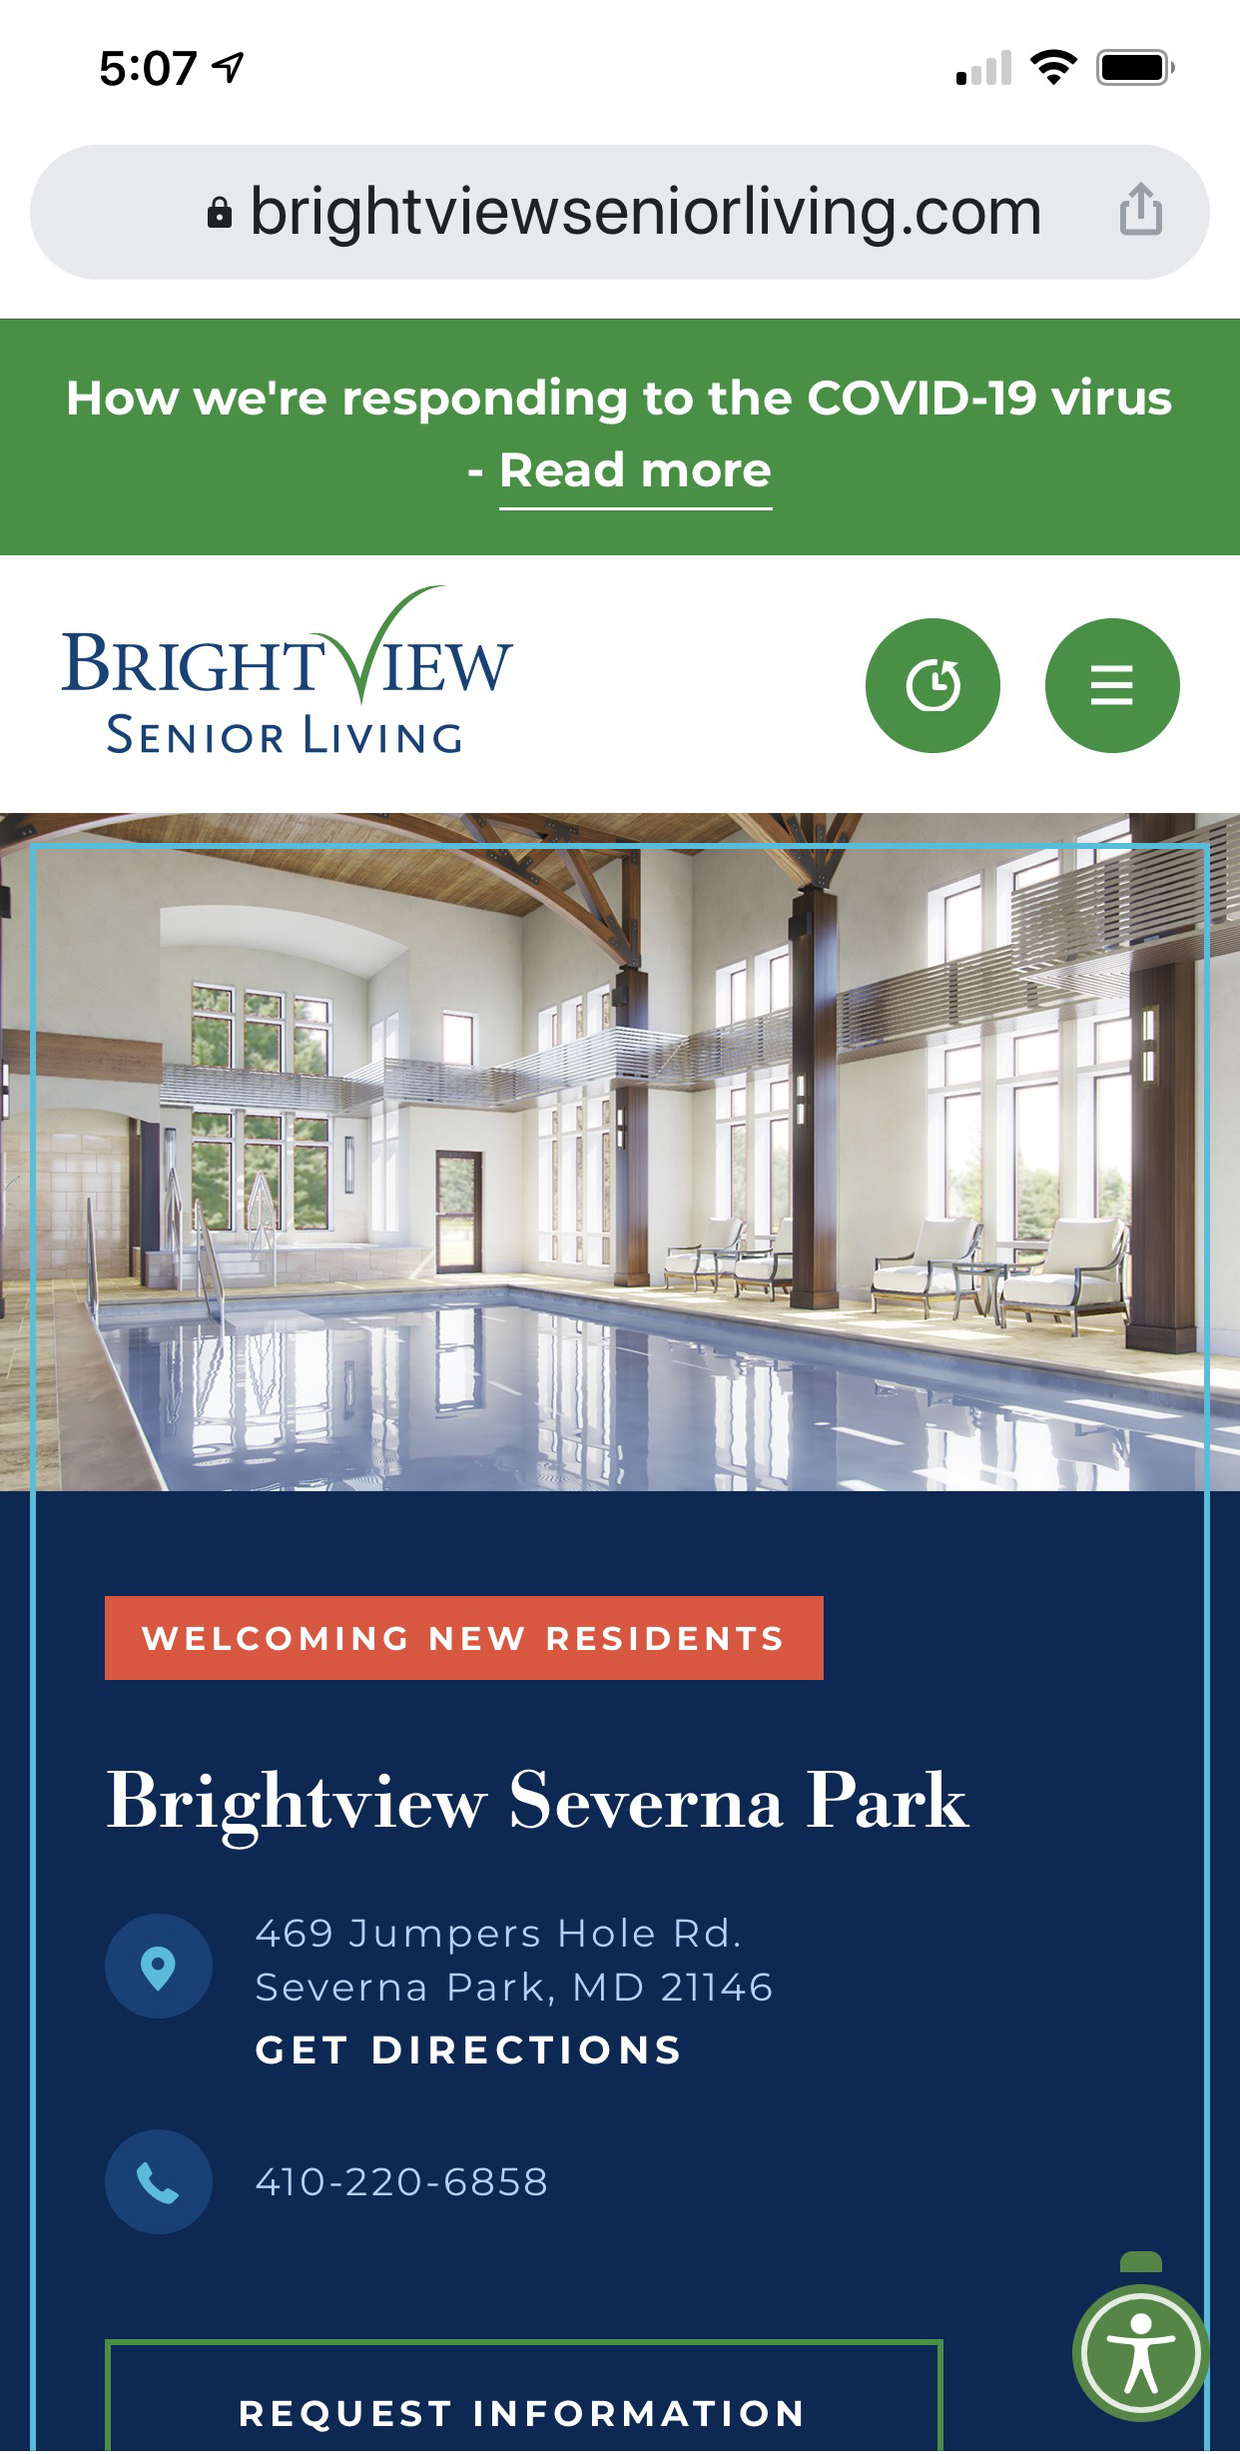
A mobile-friendly version of your website is a major ranking factor
Both made it into the map pack, but only one made mobile a priority. Which one would you click?
Most visitors view websites on mobile
Google prefers mobile
Your website must appease both audiences in appearance and functionality
Websites that aren’t mobile-friendly lose business to competing websites that are.
<
<

Slide 8
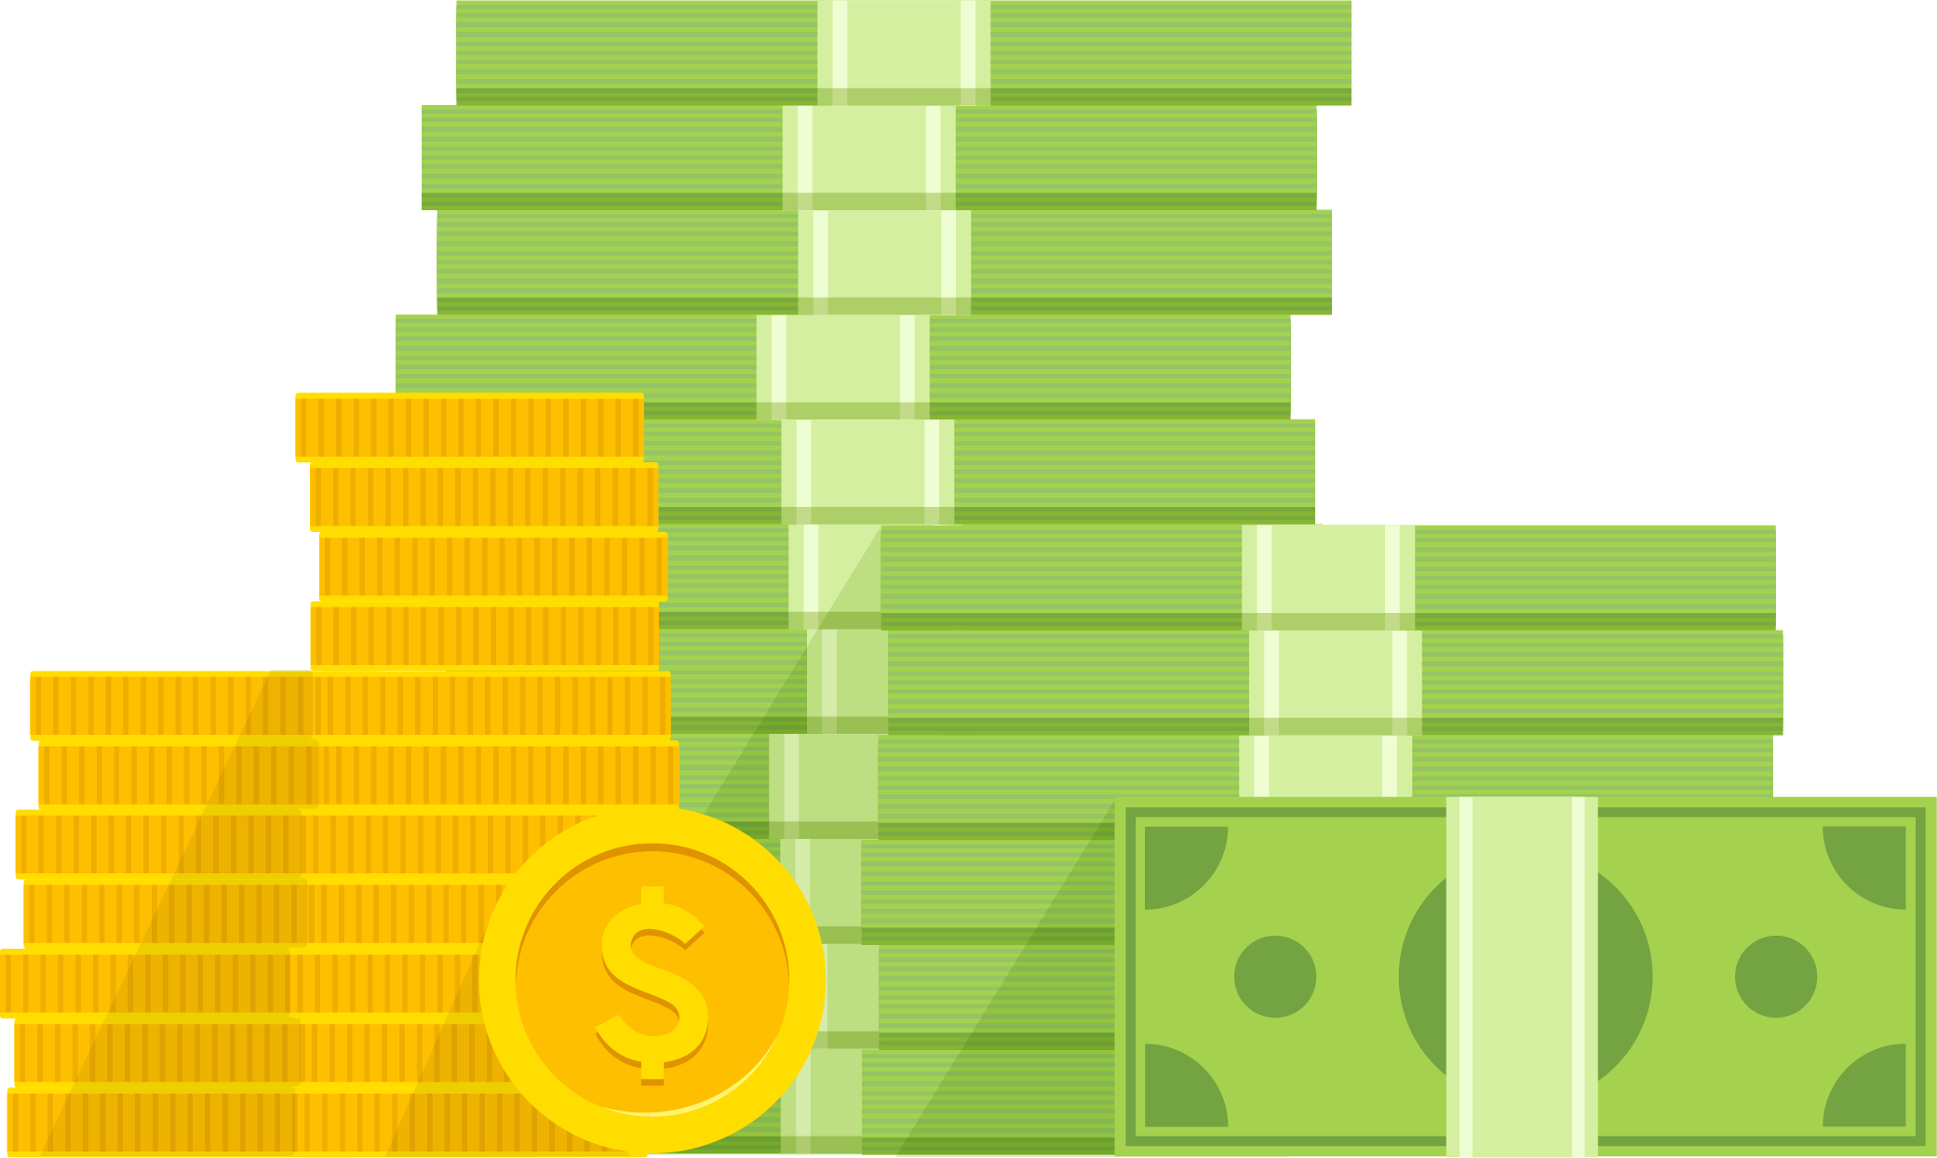
Pay Per Click “PPC” / Paid Search
What It Doesn’t
Do Well What
What It Does Well
Rented VS Owned Success
Increased Cost, Not a Long-Term Solution
Drives Both Qualified & Unqualified Leads
Fast Results
Builds Awareness
Large Target Audience
Drives Traffic
Variety of Platforms
Nurturing / Retargeting Potential

Slide 9
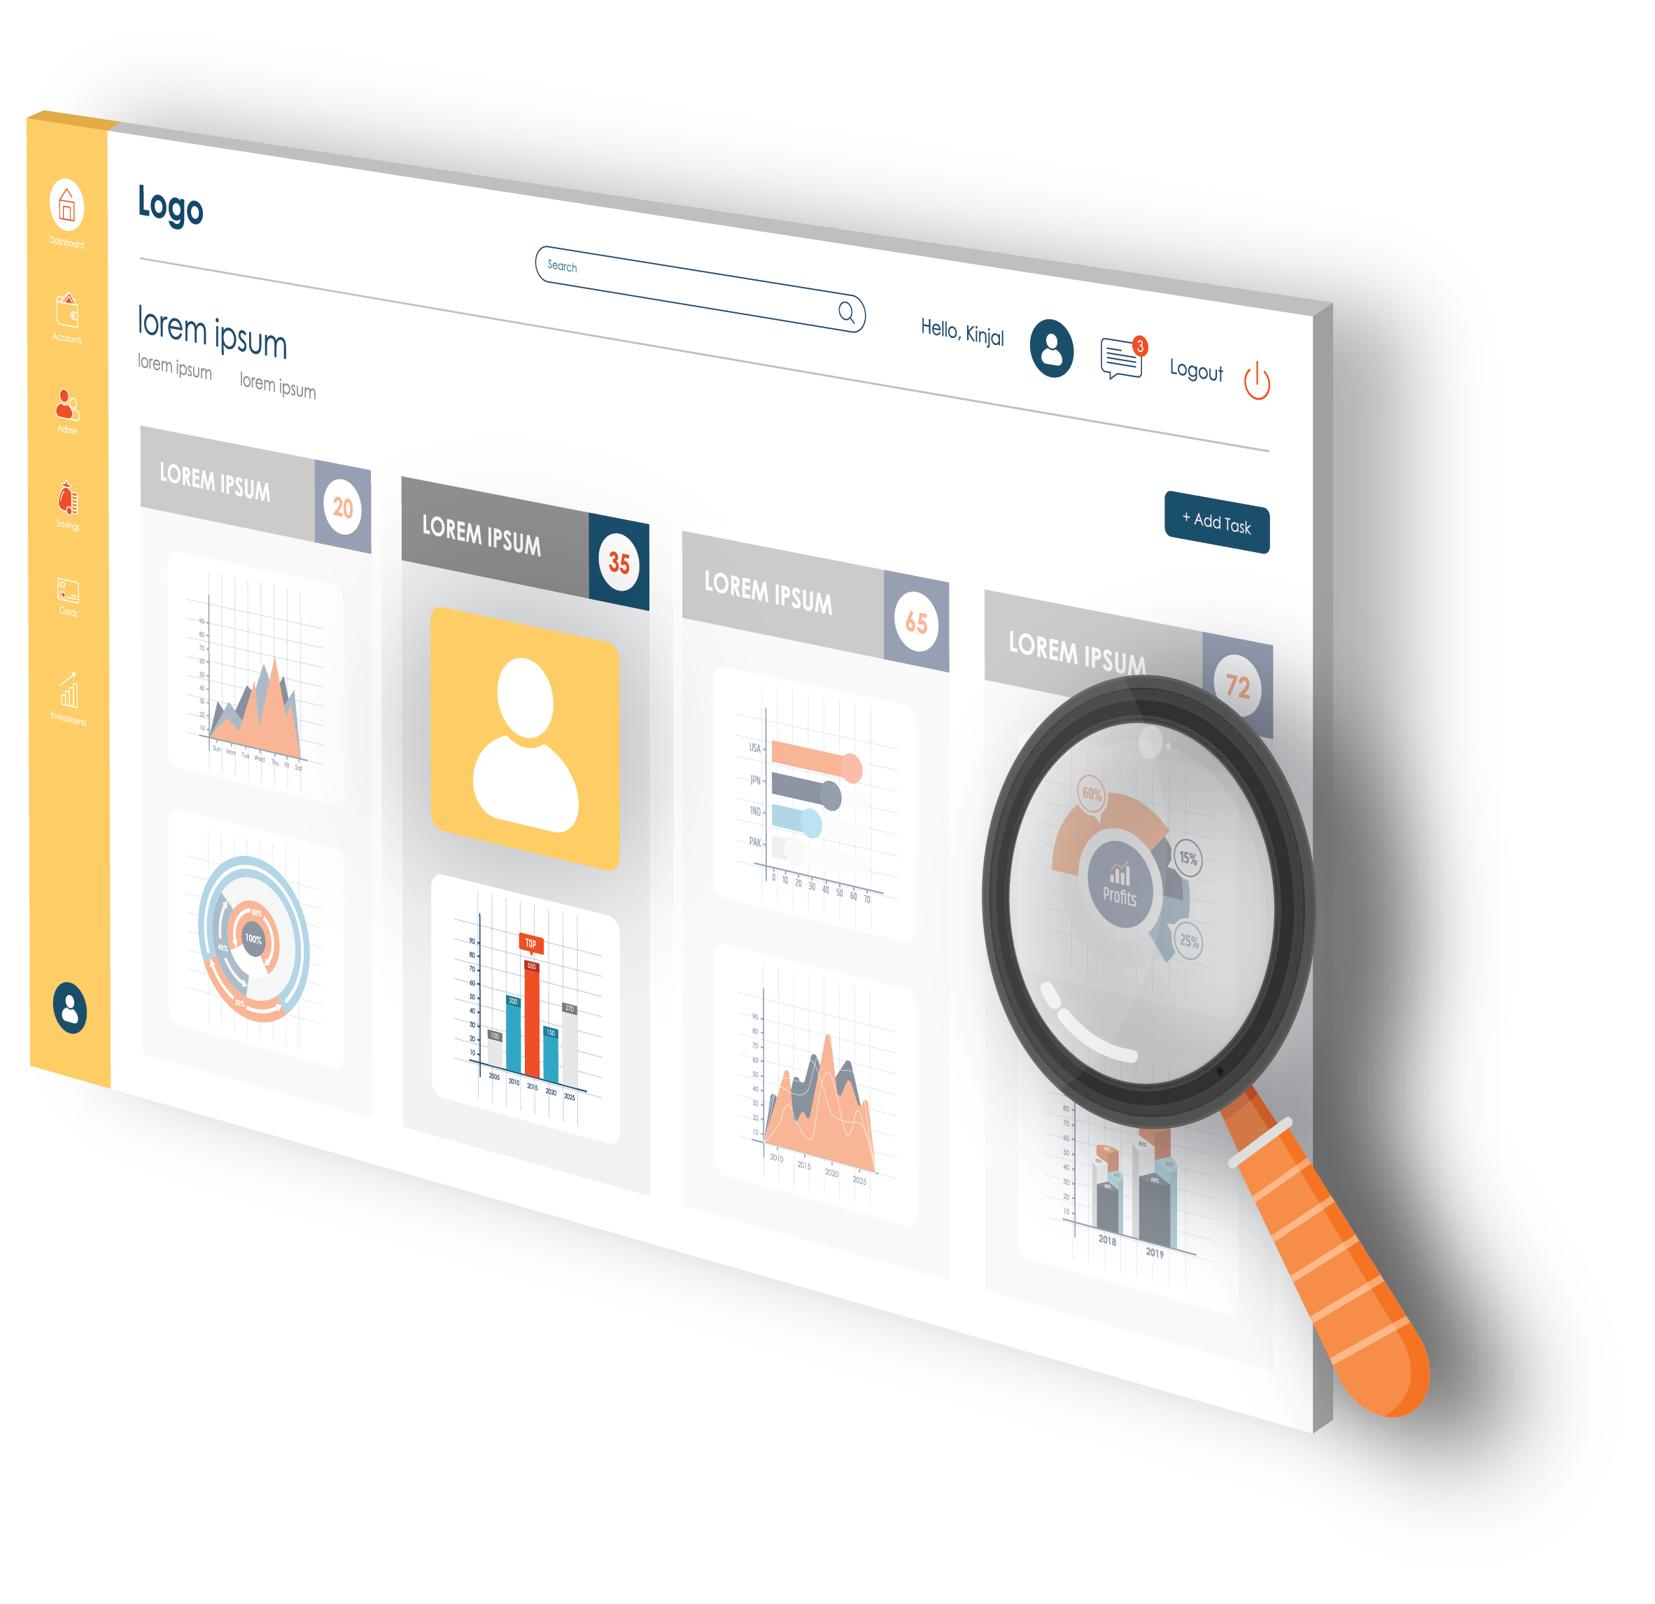
Integration & Automation
CRM & CALL TRACKING SOFTWARE
Better Attribution = Lower Cost per Placement/Child Served
Associate calls with source & decision maker conversations
Automate workflows or dashboards
Clear picture of metrics to focus on
Develop a complete road map from marketing channel to call to child served
Analyze phone calls contained in reports
Pinpoint which digital campaigns are effective & work faster

Slide 10
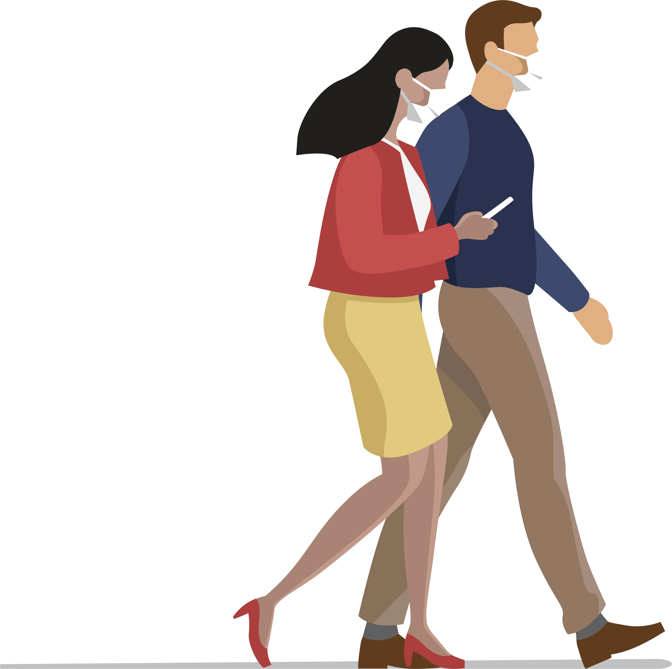
The Pandemic + How It Affects Your Digital Marketing Strategies
New Obstacles - Messaging Against Fear
Prospective residents postponing their move
Amenities selling points, now points of concern
Homecare alternatives
Safety protocols
2021 Digital Marketing Landscape
Regular Timely COVID-specific content Website, GMB, Social, eNewsletter, Press Release
Desktop computers usage up!!!
Paid Ads are more hyper-localized due to minimal desire & ability to travel
Virtual Reality Solutions
Locally focused/keyworded senior living blog

Slide 11
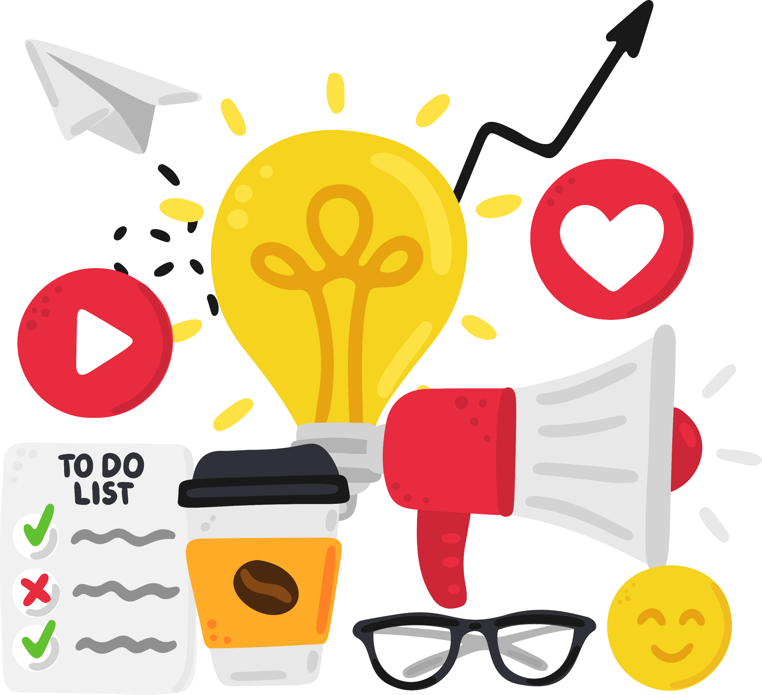
Website, SEO + PPC
Action Items
Direct more budget and time towards developing your digital outreach VS in-person tours
Create fresh content (written + video) & multiply it’s value by posting to GMB, Social, YouTube
Digital marketing as a channel was largely unaffected compared to traditional marketing segments, your approach and messaging need to be timely!!!!!
Take advantage of the fact that you have a captive audience—especially adult children decision makers. Therefore, provide effective educational messaging & updated content that addresses their current concerns

